Slide 1
Welcome to Section 5

Slide 2
Agenda
Naive Bayes Recap
Decision Trees Recap
Random forests Recap
Adaboost Recap
Demo

Slide 3
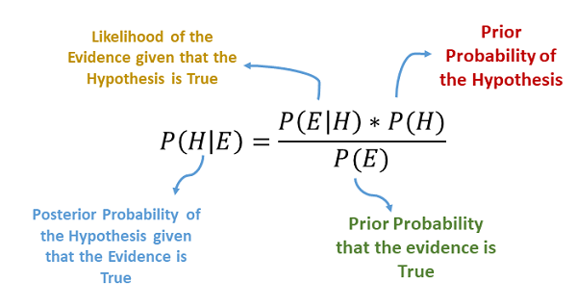
Naive Bayes Overview
Use Bayes Rule to “invert” the question
P(E|H) and P(H) are very easy to find from data, if using the Naive Bayes assumption
P(H) is easy as well and we do not need P(E) because it is just normalization factor
Naive Bayes assumption is that all features are independent
Very rarely true, but useful in practice.

Slide 4
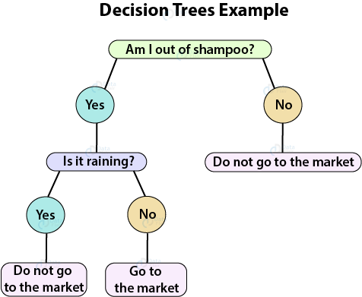
Decision Trees Overview
Basically a series of nested questions
Usually used for categorical classification and probability estimation
Can also be used for numerical regression
Simple Classification tree

Slide 5
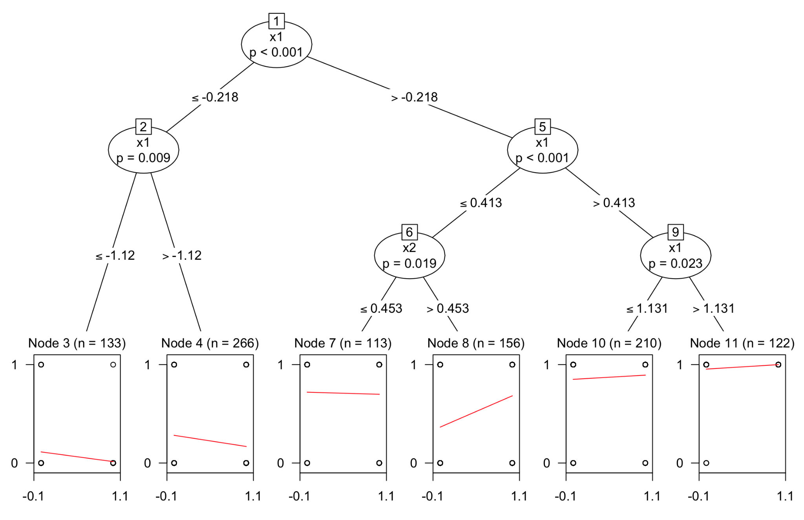
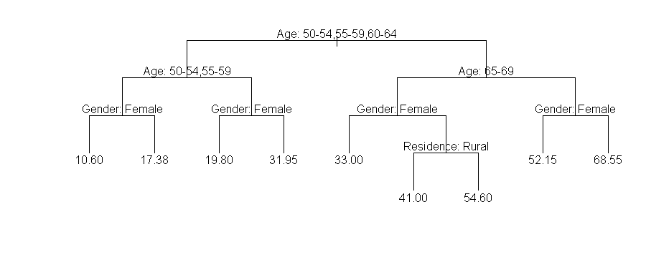
Regression Trees
Not needed. Just FYI
Output at leaf can a scalar (Lower picture)
Or even a linear regression (Right picture)
Notes:
Sigmoid function used for logistic regression
Logistic regression is a probability classifier- have magical thing that learns coefficients, apply coefficients to the features to get a score and then feed the score to the sigmoid function to get a probability to make a prediction

Slide 6
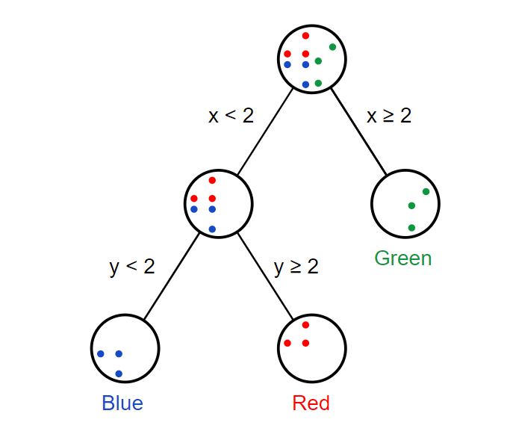
Decision Trees question types
What kind of questions do we put at the nodes
With categorical features
Split node for each possible value of category
E.g. Major -> CSE, STATS, BIO
Numerical feature
Pick a split value and compare

Slide 7
Decision Trees summary
Interpretable (When not too deep)
Low bias (When not too deep enough)
High variance (When deep)
Easy to train
Prone to overfitting (when too deep)
Conclusion:
Cannot satisfy all needs
Solution:
Random Forests

Slide 8
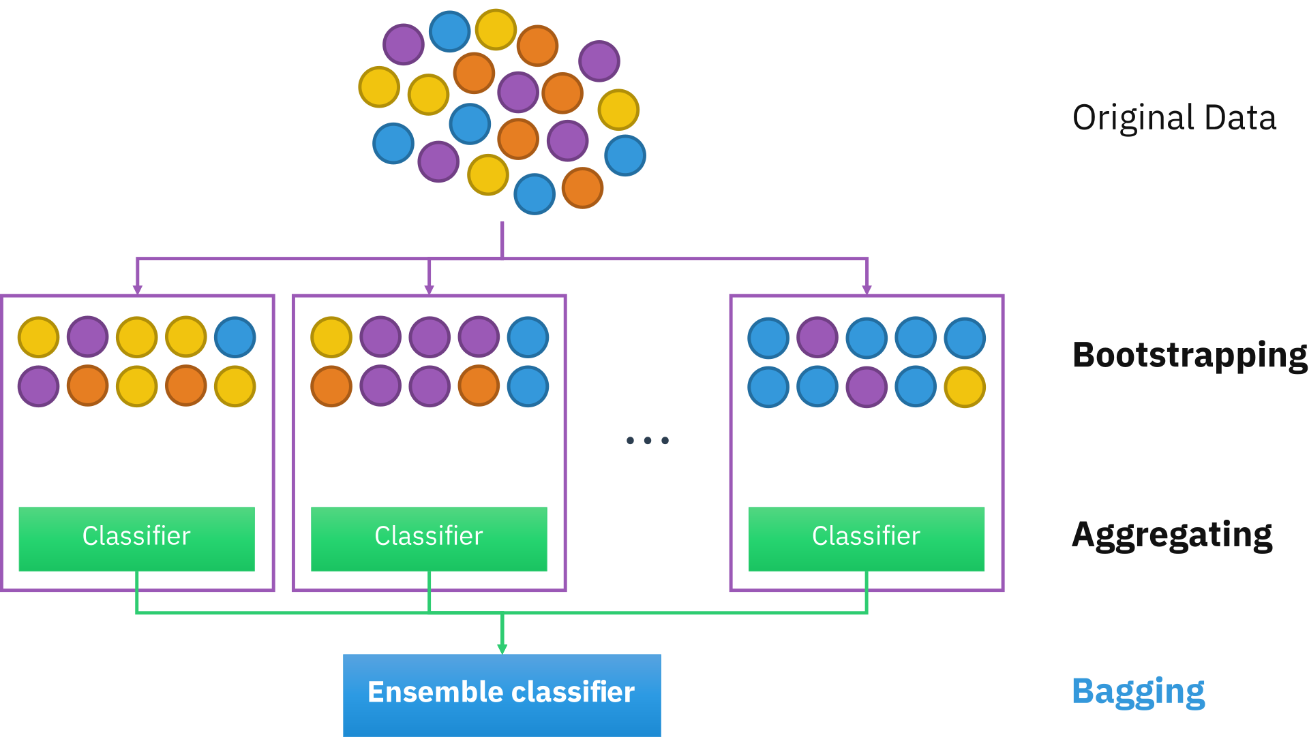
Random Forest
Bootstrapping
Randomly create many new datasets from original
Aggregation
Train a classifier on each new dataset
Majority voting
Bagging (Bootstrap Aggregation)

Slide 9
Random Forest #2
When classifier is decision Tree we have RANDOM FOREST
Bagging is a technique to reduce variance at expense of computational time
Perfect combination with high-variance trees resulting in low variance, low bias classifiers

Slide 10
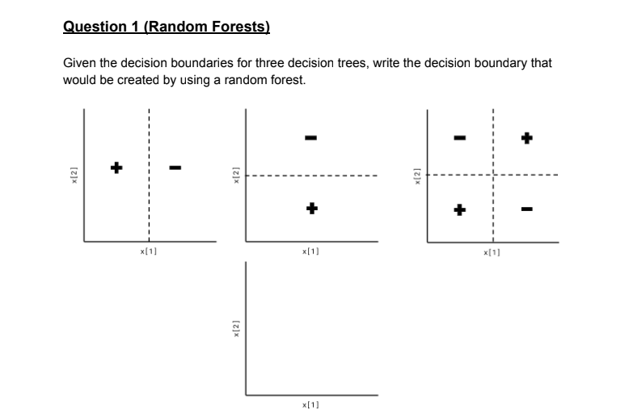
Random Forest Question

Slide 11
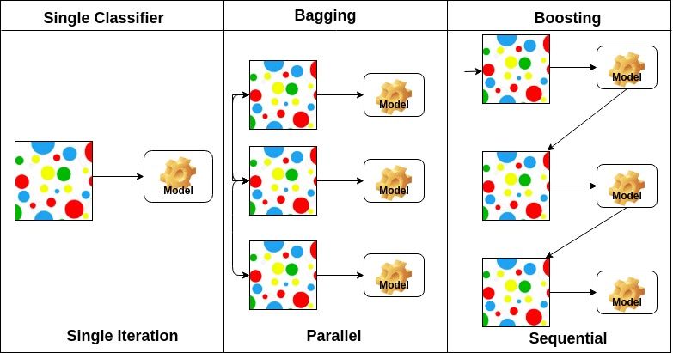
AdaBoost
Random forests are a parallel extension to basic classification (training 1000s of models independently)
AdaBoost is the sequential extension.
Here the next model depends on the performance of the previous models
Adaptively each new model corrects the mistakes of the previous ones.
A way of combining “Weak Learners”

Slide 12
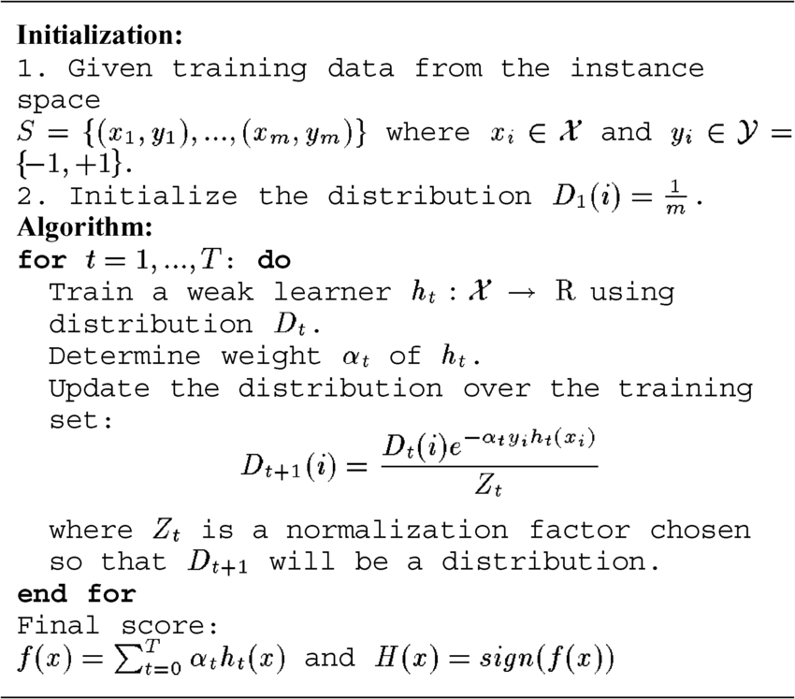
AdaBoost algorithm overview
Important concepts
Example weights (w_{i})
Each example starts with weight=1 and gets updated each iteration
Model weights (a_{j})
Each model gets a weight based on its performance
Final classifier is a weighted combination of all models

Slide 13
AdaBoost continued
Usually we use decision stumps - decision trees with depth 1
We need “weak” learners, a classifier with relatively low accuracy
Compared to decision trees
Reduce overfitting
Increases validation accuracy
Number of iterations?
Use hyperparameter tuning

